Slide 1
Mobile Robot Fundamental Assemble Guidance

Slide 2
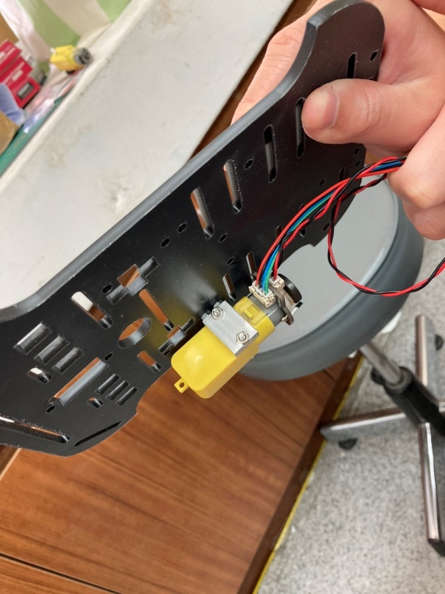
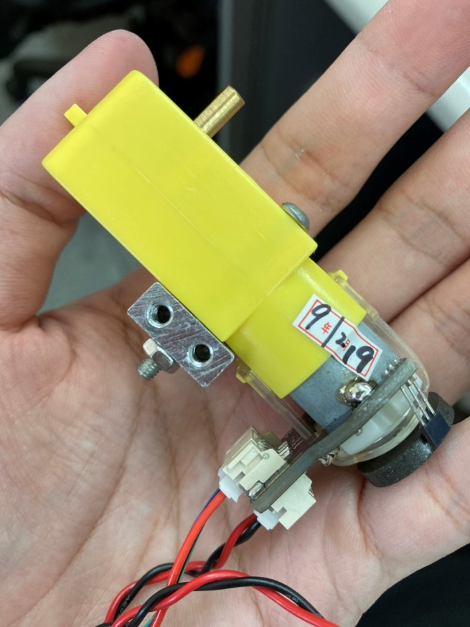
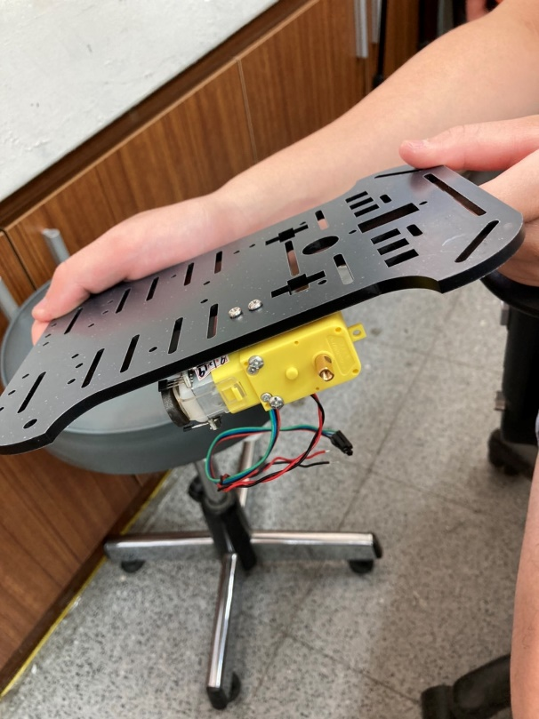
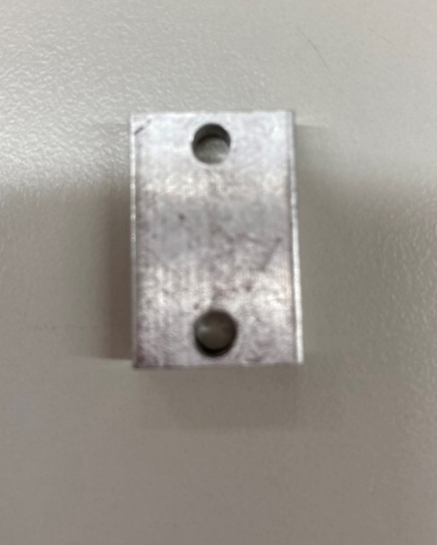
First, use 30mm screw to combine the DC motor and the component A.
Second, lock the motor to the chassis.
Component A

Slide 3
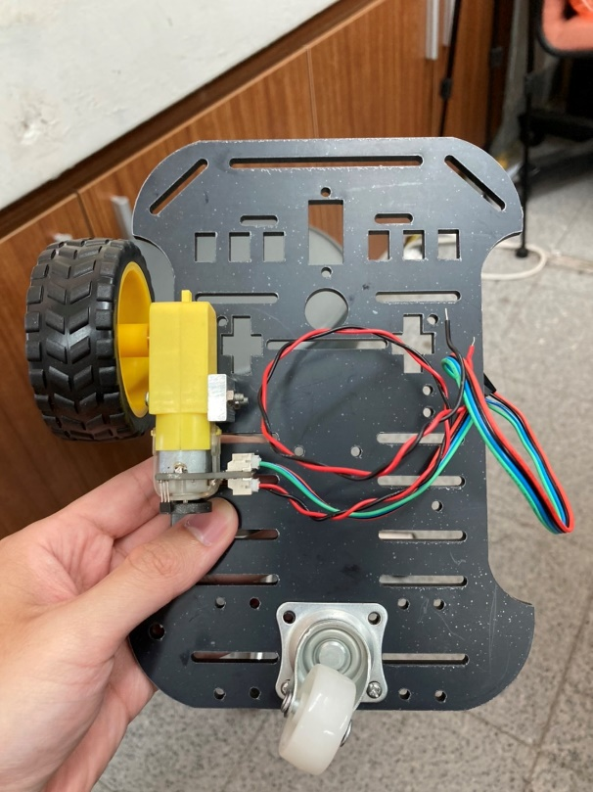
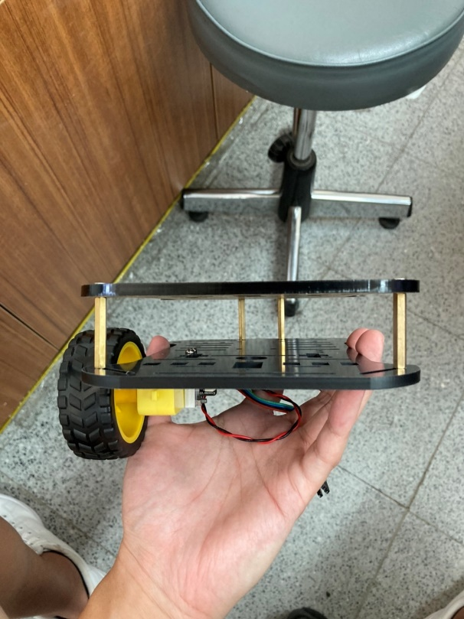
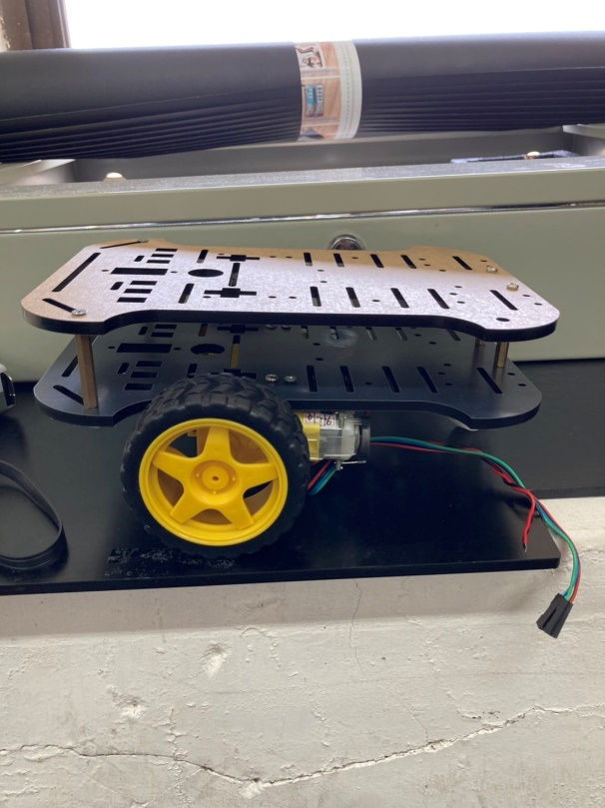
Lock the caster wheel to the chasis, and then, use four copper pillars to combine the two chassis.
After completing the above steps, your mobile robot can be assembled.
You should set your Rpi, Arduino and motor drive according to your design.

